Slide 1
Econ 200 Module 6 Lecture 15

Slide 2
Outline
Product Differentiation and Monopolistically Competitive Markets
Marginal Revenue and Downward Sloping Demands
Profit Maximization
Long Run Profits
Reading: Ch 15

Slide 3
Imperfect Competition
We have seen market structures at the two extremes of the competition spectrum:
Perfect Competition – Lowest prices, highest quantities, maximizes surplus
(Single Price) Monopoly – Highest prices, lowest quantities, maximizes profits
But there are many models of market structures that fall between these extremes. What these “imperfectly competitive” models have in common is:
Q_{m}<Q_{ic}<Q_{pc}
DWL_{pc}(=0)<DWL_{ic}<DWL_{m}
Notes:
In perfect competition, consumers are indifferent between the products of competing firms. In a monopoly market, the product has no close substitutes. Between these two extremes are markets in which products have substitutes that are close but not perfect. Consumers might be willing to pay a bit extra, but if the price differential is too large, they will choose a substitute product instead. For example, the most enthusiastic Elvis fans will deem that Elvis’s records are less interchangeable with those of other artists, so Sun could charge higher prices without fear of losing sales. But less enthusiastic fans might buy a Johnny Cash record instead. Even when a firm’s product is not really very different from other products on the market, it may be possible to convince customers that the product is different, and thereby persuade them to pay more for a particular brand.

Slide 4
Monopolistic Competition
Monopolistic competition describes a market with many firms that sell similar, but differentiated, goods and services.
Able to earn a positive profit in the short run by selling a differentiated product.
Offer goods that are similar to competitors’ products but more attractive in some ways.
Firms have an interest in persuading customers that their products are unique, a practice known as product differentiation.
This is the role of advertising and branding.
Notes:
In perfect competition, consumers are indifferent between the products of competing firms. In a monopoly market, the product has no close substitutes. Between these two extremes are markets in which products have substitutes that are close but not perfect. Consumers might be willing to pay a bit extra, but if the price differential is too large, they will choose a substitute product instead. For example, the most enthusiastic Elvis fans will deem that Elvis’s records are less interchangeable with those of other artists, so Sun could charge higher prices without fear of losing sales. But less enthusiastic fans might buy a Johnny Cash record instead. Even when a firm’s product is not really very different from other products on the market, it may be possible to convince customers that the product is different, and thereby persuade them to pay more for a particular brand.

Slide 5
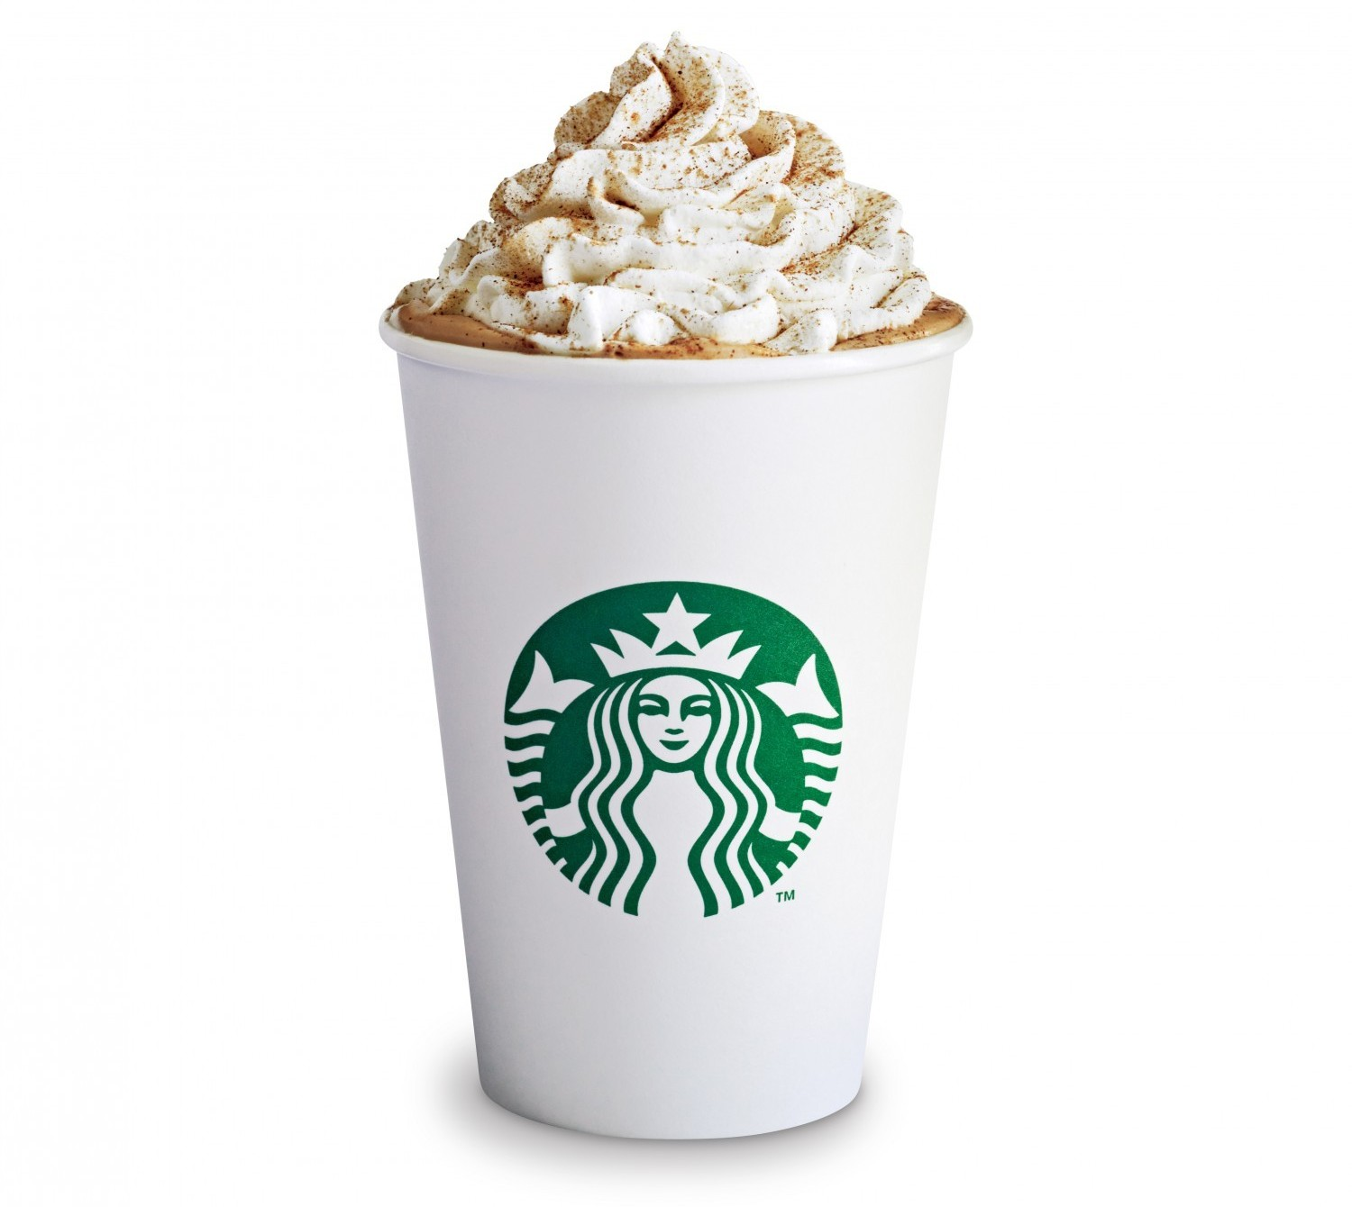
Product Differentiation as Distance
Perfect competition – identical products means all firms close to each other

Slide 6
Product Differentiation as Distance

Slide 7
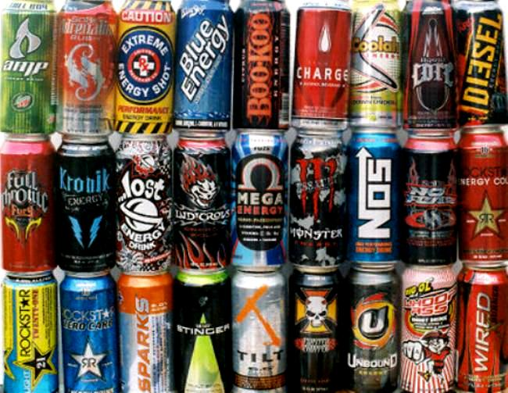
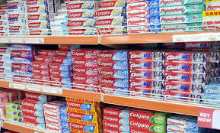
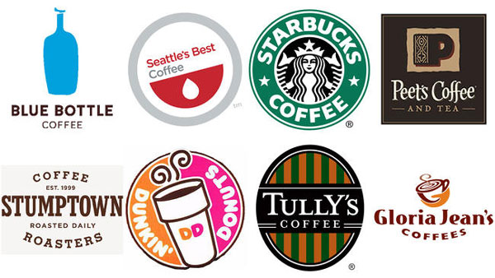
Product Differentiation
Now, instead of physical space, think of products being differentiated in “characteristic space”…

Slide 8
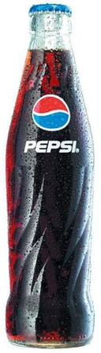
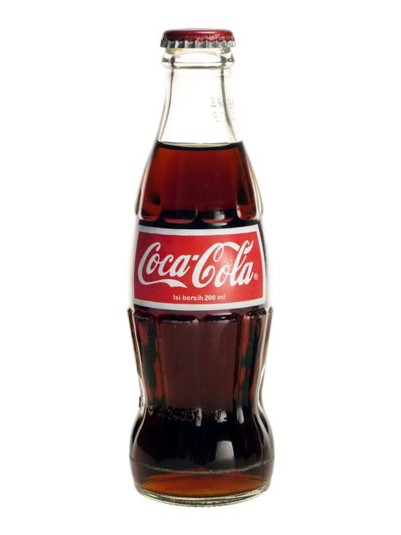

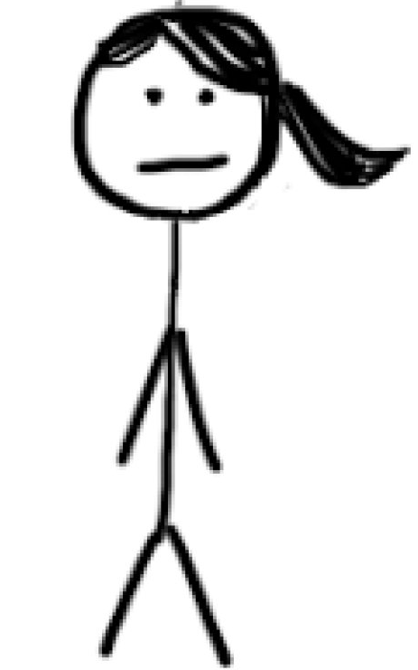
Product Differentiation
We can even think of characteristic space as an actual distance:
Me
You
$
Sweeter
Pepsi is a more costly choice for me – either because of the physical distance I have to travel, or because of how far I have to stray from my ideal product characteristic (sweetness).

Slide 9
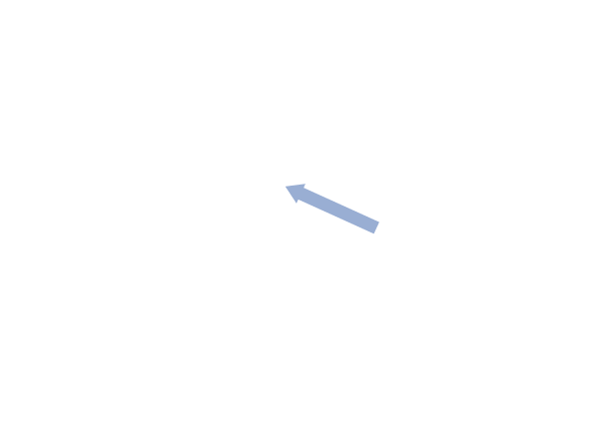
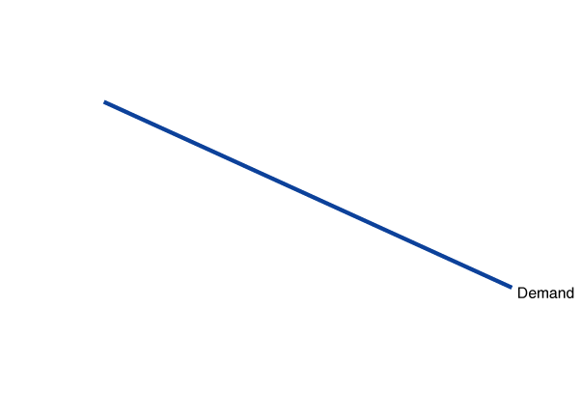
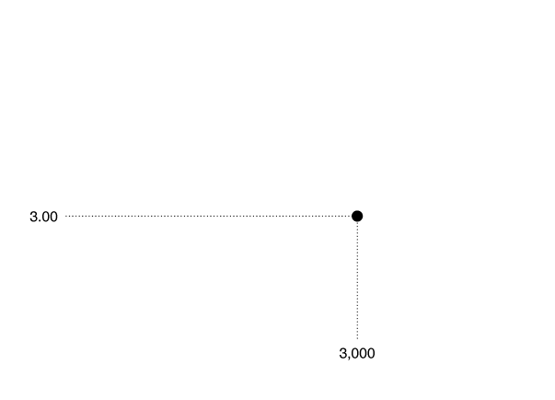
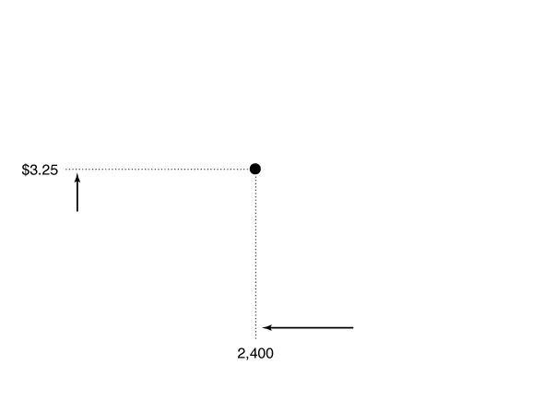
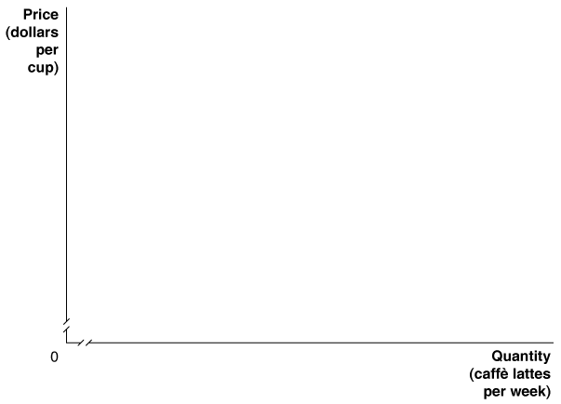
The Demand Curve for a Monopolistically Competitive Firm
If some consumers have a taste for Sbx lattes over lattes from Tullys, Peets, etc…
Then when sbx latte price goes up, it will lose some, but not all, of its customers.
Notes:
If a Starbucks increases the price of caffè
lattes, it will lose some, but not all, of its customers.
In this case, raising the price from
$3.00 to $3.25 reduces the quantity of caffè
lattes sold from 3,000 to 2,400. Therefore,
unlike a perfect competitor, a Starbucks coffeehouse
faces a downward-sloping demand
curve.

Slide 10
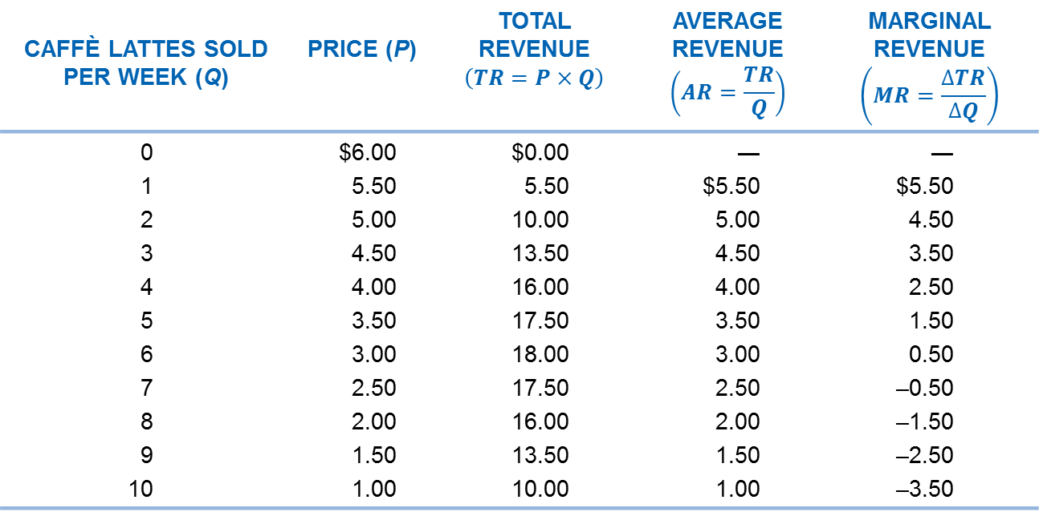
Marginal Revenue When Demand Is Downward-Sloping
CAFFÈ LATTES SOLD PER WEEK (Q) | PRICE (P)
0 1 2 3 4 5 6 7 8 9 10 | $6.00 5.50 5.00 4.50 4.00 3.50 3.00 2.50 2.00 1.50 1.00
$0.00 5.50 10.00 13.50 16.00 17.50 18.00 17.50 16.00 13.50 10.00 | ― $5.50 5.00 4.50 4.00 3.50 3.00 2.50 2.00 1.50 1.00
― $5.50 4.50 3.50 2.50 1.50 0.50 –0.50 –1.50 –2.50 –3.50
Total revenue increases initially, then decreases; Starbucks has to lower the price in order to sell additional lattes.
Hence marginal revenue is initially positive, then negative.

Slide 11
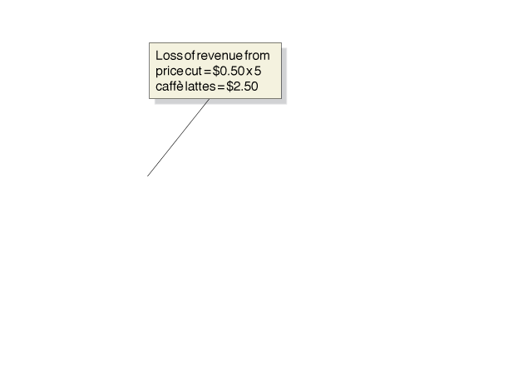


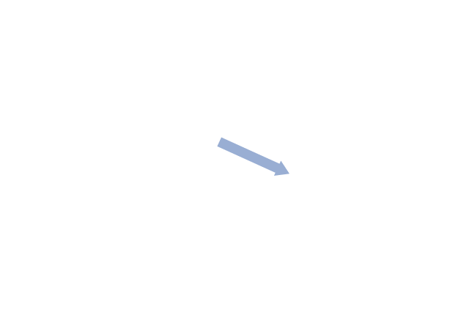
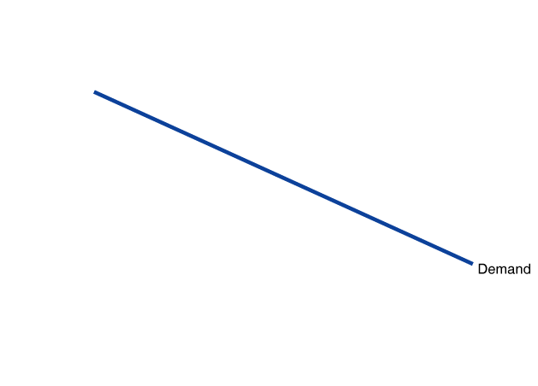
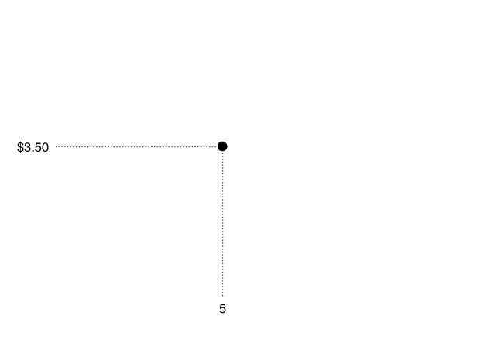
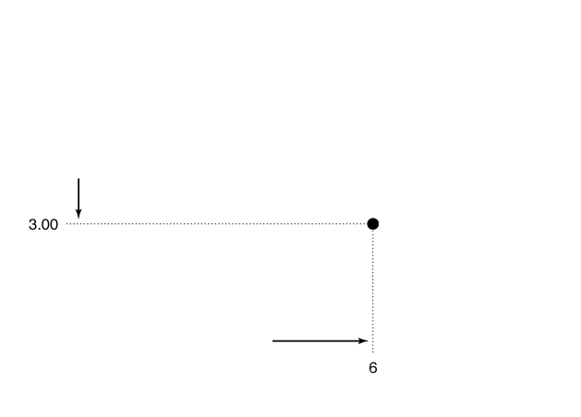
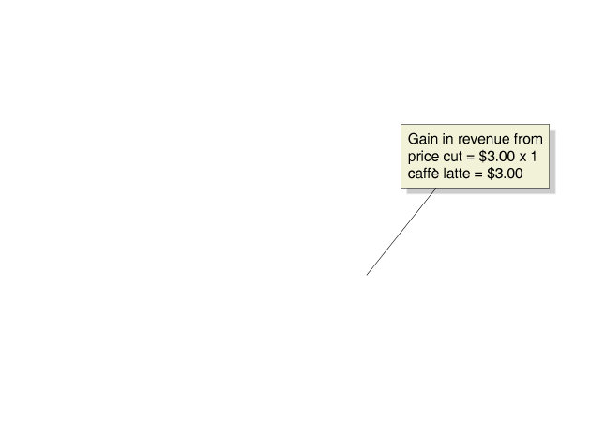
How a Price Cut Affects Firm Revenue
When Starbucks reduces the price of a caffè latte, it can sell more output.
→ Quantity effect
But its revenue decreases also. In order to sell the additional caffè latte, it must reduce the price on all cups it will sell.
→ Price effect
Notes:
If a local Starbucks reduces the price of a
caffè latte from $3.50 to $3.00, the number
of caffè lattes it sells per week will increase
from 5 to 6. Its marginal revenue from selling
the sixth caffè latte will be $0.50, which
is equal to the $3.00 additional revenue
from selling 1 more caffè latte (the area of
the green box) minus the $2.50 loss in revenue
from selling the first 5 caffè lattes for
$0.50 less each (the area of the red box).

Slide 12
Marginal Revenue
Starbucks’ marginal revenue for selling the additional latte is equal to the green area minus the pink area: the quantity effect minus the price effect.
But…
Quantity effect = price
→MR < P

Slide 13
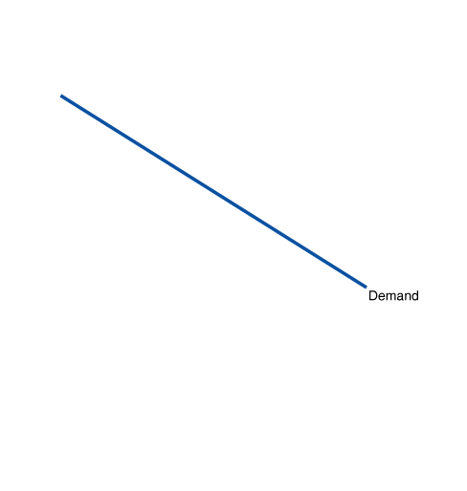
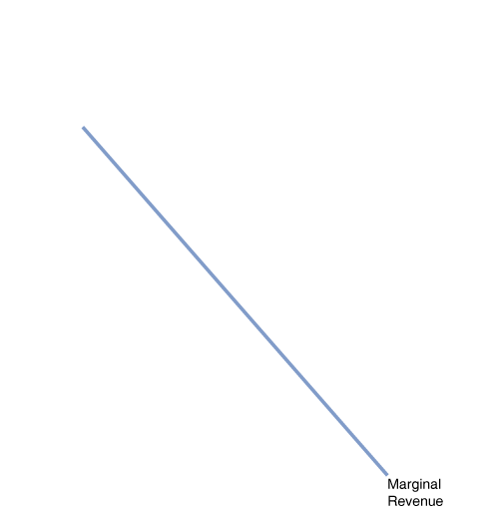
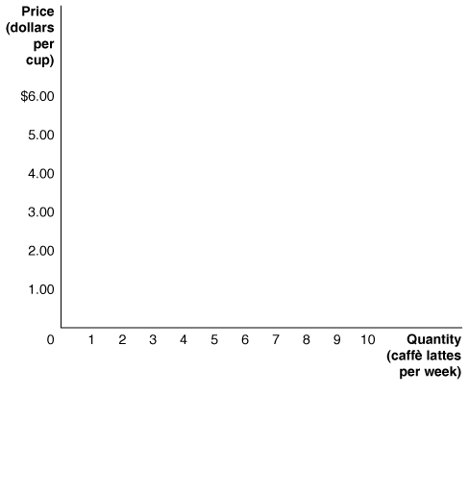
Demand and Marginal Revenue Curves
After the 6th latte, reducing the price in order to increase sales results in revenue decreasing → negative marginal revenue
Notes:
Any firm that has the ability to affect the price
of the product it sells will have a marginal
revenue curve that is below its demand curve.
We plot the data from Table 13.1 to create
the demand and marginal revenue curves.
After the sixth caffè latte, marginal revenue
becomes negative because the additional revenue
received from selling 1 more caffè latte is
smaller than the revenue lost from receiving a
lower price on the caffè lattes that could have
been sold at the original price.

Slide 14
Profit Maximization
Profit maximization requires producing until the marginal revenue from the last unit is just equal to the marginal cost: MC = MR.
This same rule holds for all firms that can marginally adjust their output.

Slide 15
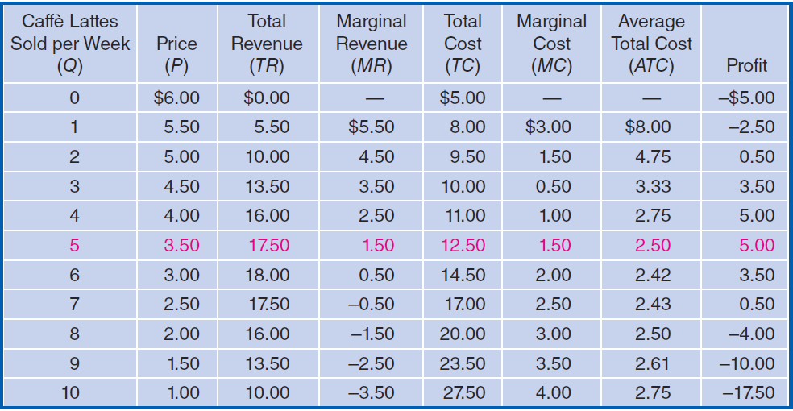
Profit Maximization Using a Table
The 1st, 2nd, 3rd, and 4th caffè lattes each increase profit: MC < MR.
The 5th does not alter profit: MC = MR.
The 6th and subsequent caffè lattes decrease profit: MC > MR.

Slide 16

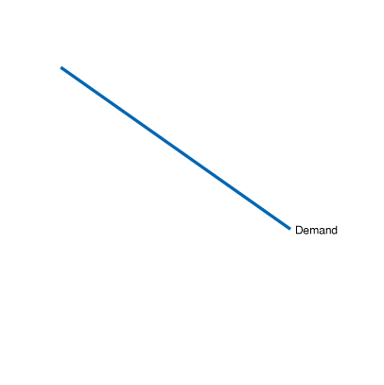
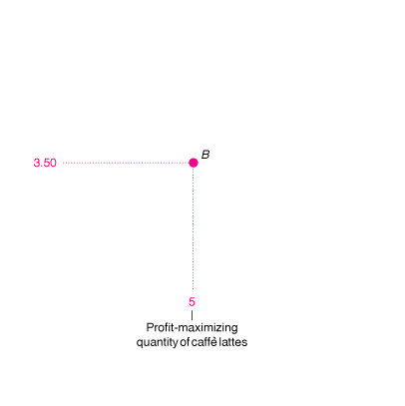
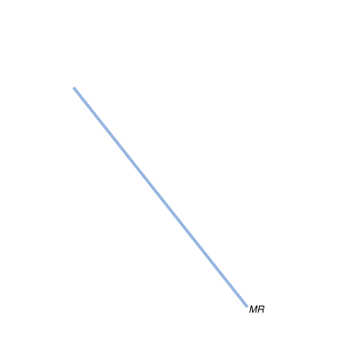
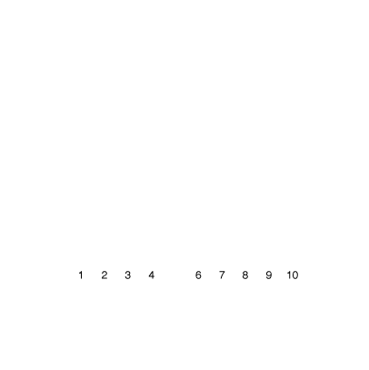
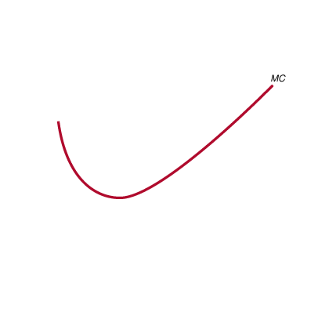
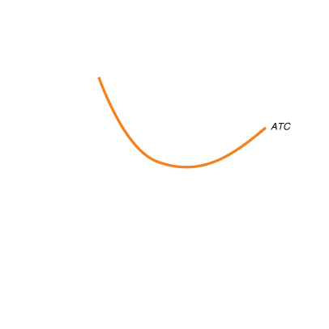
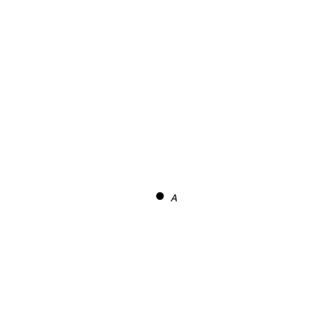
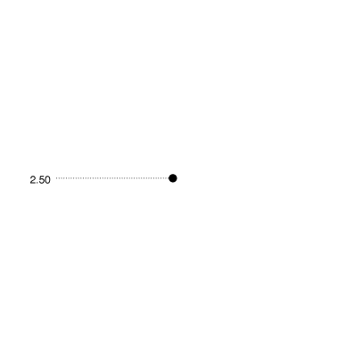
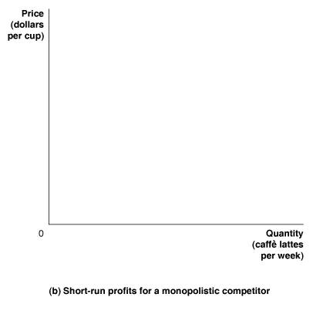
Identifying Profit Graphically
Use MC=MR to identify the profit-maximizing quantity like with monopolies
Profit = (P-ATC)*Q
We will assume profit > 0 as a result of product differentiation. If not, maybe they should have been satisfied with perfect competition!

Slide 17
Product Differentiation in the long run

Slide 18

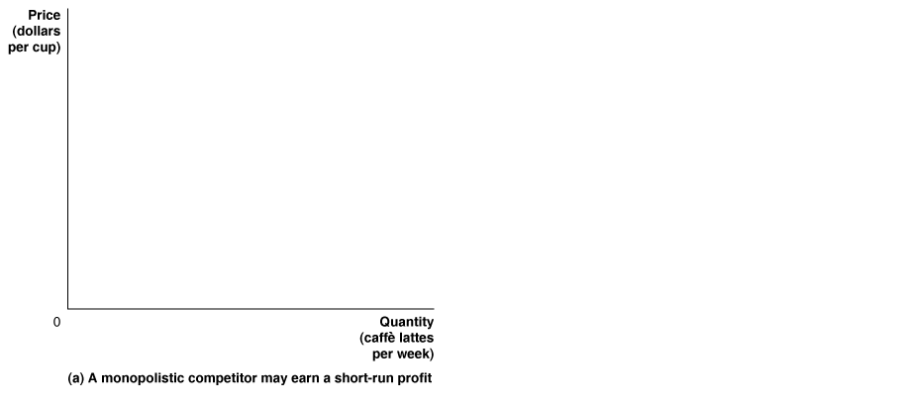
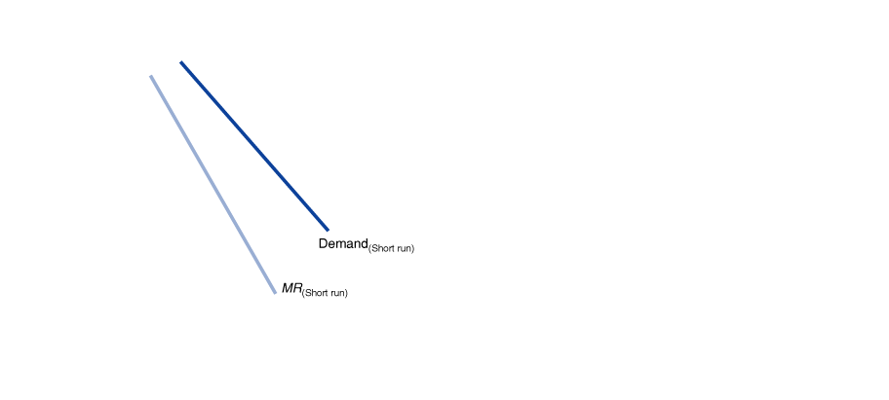
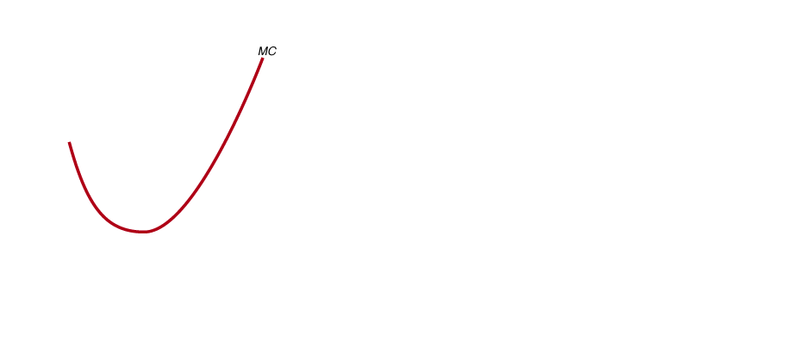

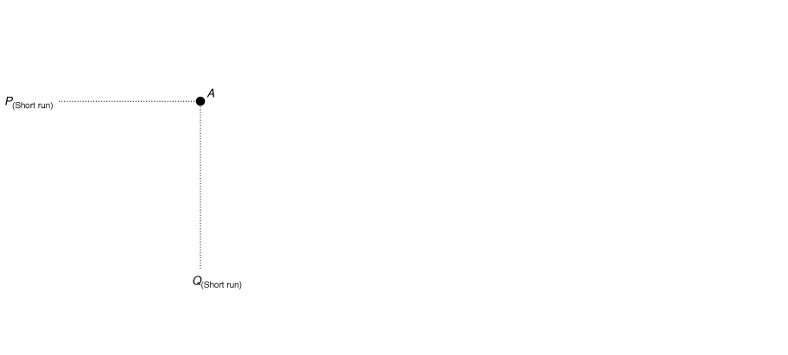

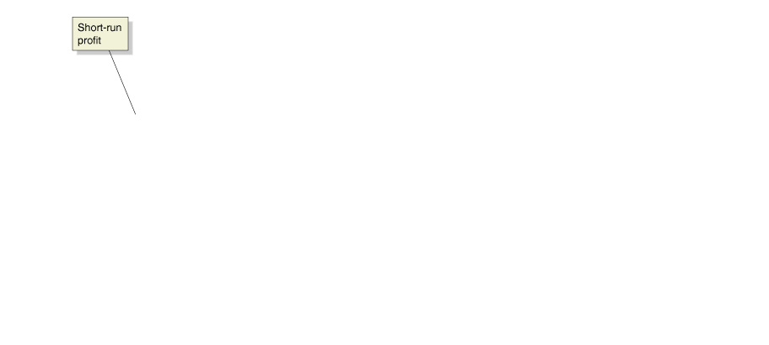
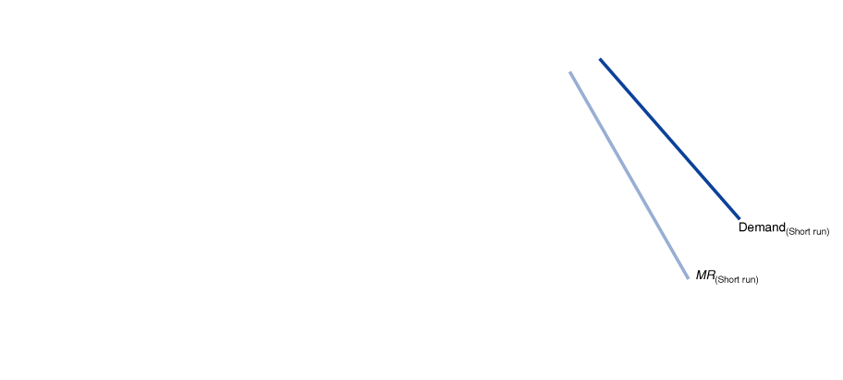
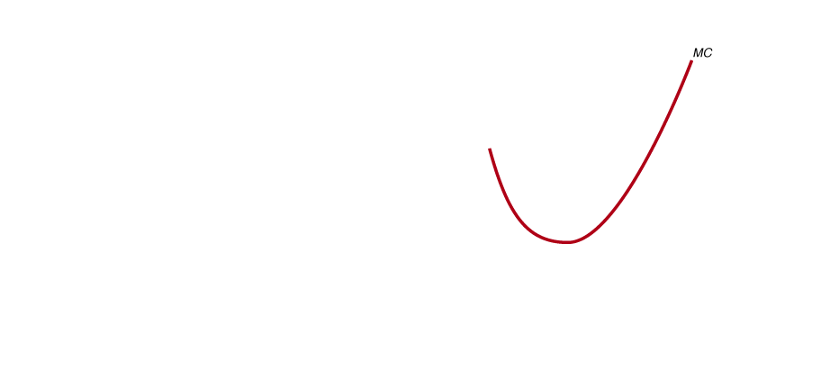
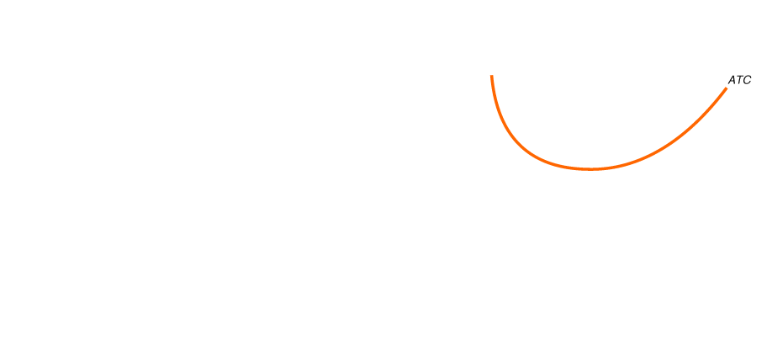
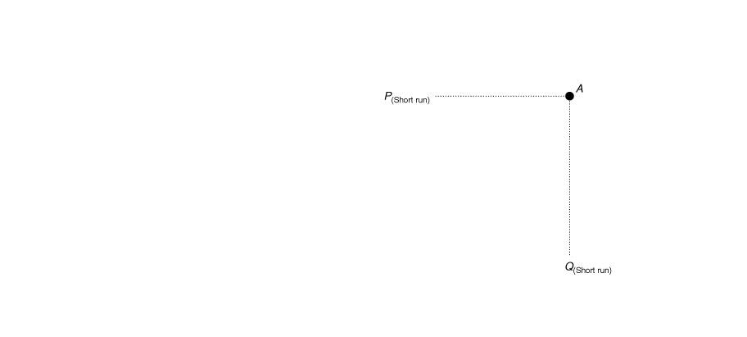
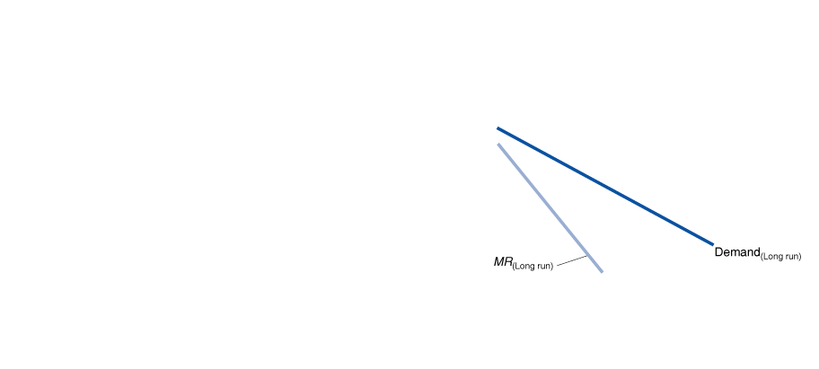
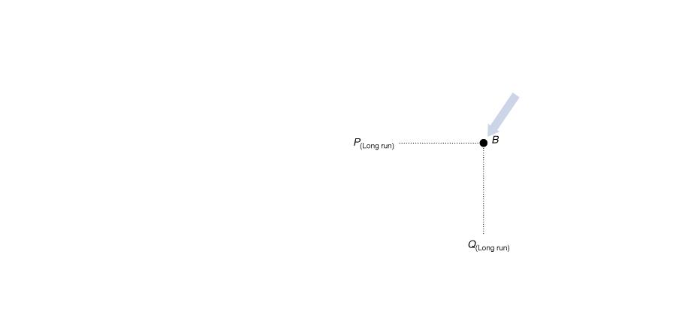
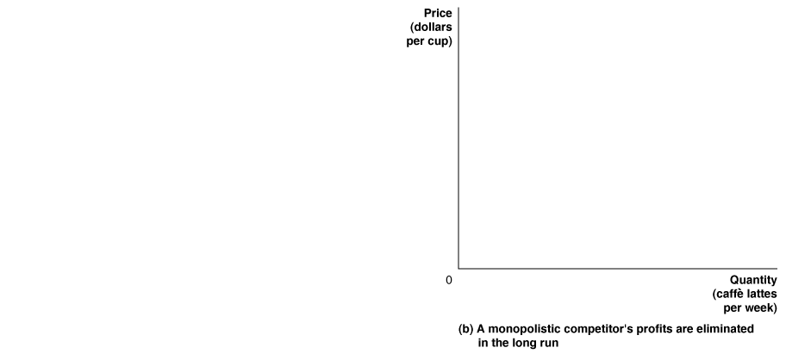
How the Entry of New Firms Affects Profits of Existing Firms
When Sbx makes a profit selling lattes, new firms enter.
Substitutes for Sbx lattes increase
Demand falls and becomes more elastic
In the long run, no profit can be made, so P = ATC (not minATC!)
Notes:
Panel (a) shows that in the short run, the local Starbucks faces the demand and
marginal revenue curves labeled “Short run.” With this demand curve, Starbucks
can charge a price above average total cost (point A) and make a profit, shown by
the green rectangle. But this profit attracts new firms to enter the market, which
shifts the demand and marginal revenue curves to the curves labeled “Long run”
in panel (b). Because price is now equal to average total cost (point B), Starbucks
breaks even and no longer earns an economic profit.

Slide 19
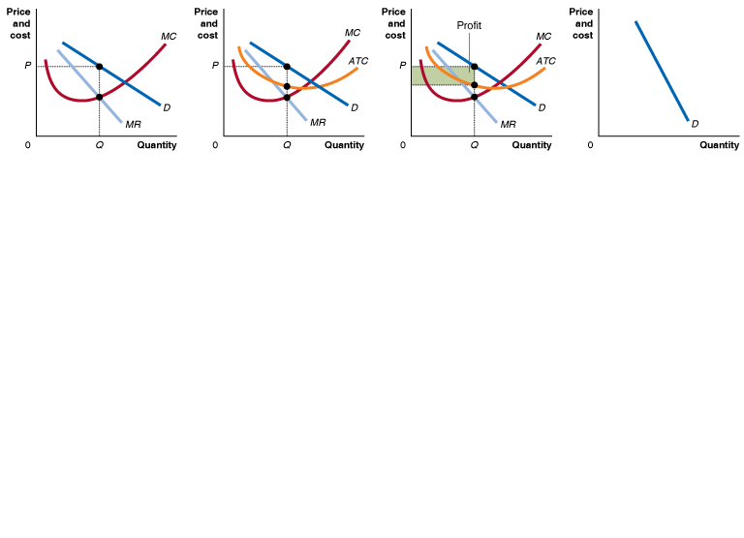
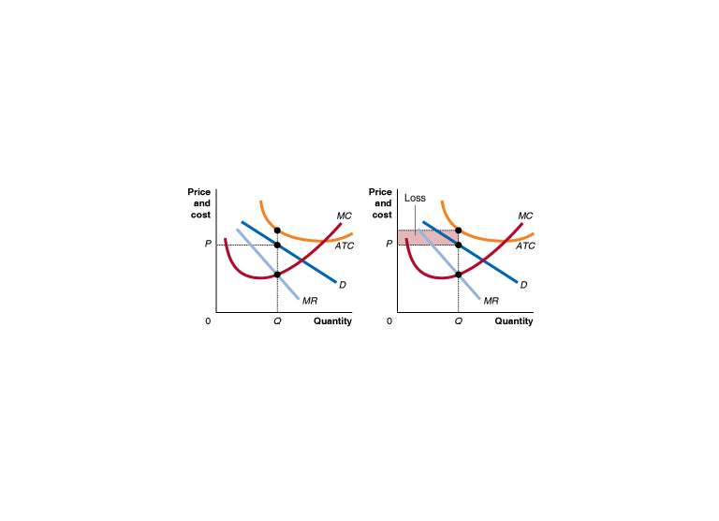
Monopolistic Competition: Short Run, Firm Making Loss
Short Run
P > MC
Short Run
P < ATC
Short Run
Economic loss
Now the firm is making a loss.
Notice that there is now no quantity for which demand (price) is above ATC; this firm must make a (short-run, economic) loss
(In the long run, some firms exit, price rises to P=ATC)

Slide 20
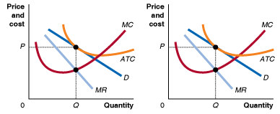
Monopolistic Competition: Long Run, Firm Breaking Even
Long Run
P > MC
Long Run
P = ATC
Long Run
Zero economic profit
In the long run, the firm must break even.
The ATC curve is just tangent to the demand curve. The best the firm can do is to produce that quantity.

Slide 21
Zero Profit in the Long Run?
Firms need not passively accept this long-run outcome. They could:
Innovate so that their costs are lower than other firms, or
Convince their customers that their product/experience is better than that of other firms, either by actually making it better in some unique way, or making customers perceive that it is better, perhaps through advertising and brand management.
Brand management: The actions of a firm intended to maintain the differentiation of a product over time.

Slide 22

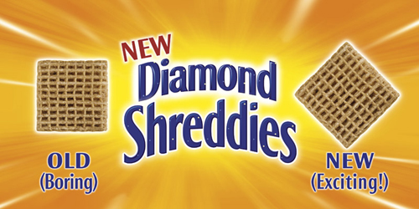
Keeping the demand curve downward sloping!

Slide 23
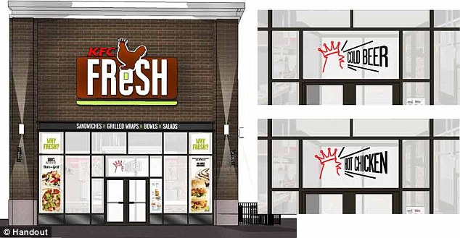
Keeping the demand curve downward sloping!
Kentucky Fried Chicken → KFC Fresh (Chipotle knockoff)
WHY???

Slide 24
Is Monopolistic Competition Efficient?
Last chapter we learned that perfectly competitive firms achieved productive and allocative efficiency.
Productive efficiency refers to producing items at the lowest possible cost.
Allocative efficiency refers to producing all goods up to the point where the marginal benefit to consumers is just equal to the marginal cost to firms.
Monopolistic competition results in neither productive nor allocative efficiency.

Slide 25
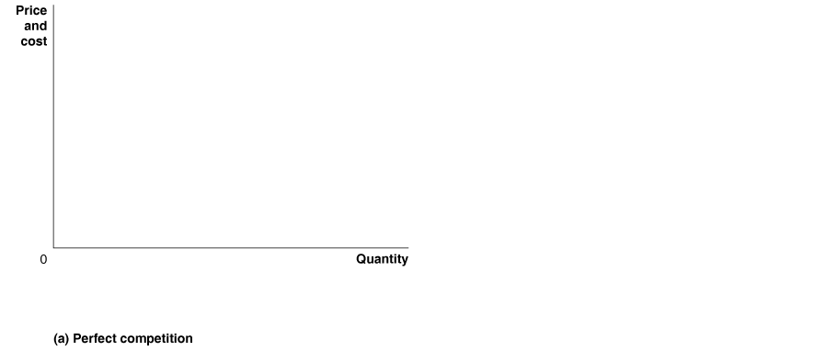









Inefficiency of Monopolistically Competitive Firms
Monopolistically competitive firms in panel (b) produce the quantity where MC=MR≠MB: not allocatively efficient.
And average cost is above its minimum point: not productively efficient.

Slide 26

Monopolistic Competition and Welfare
Monopolistically competitive firms maximize profits in the short-run by setting P>MC → Deadweight loss!
Price ($)
Consumer surplus
Producer surplus
Profit/producer surplus
Deadweight loss
MC
ATC
4.70
3
D
MR
0
47
Elvis records (thousands)
Notes:
The less differentiated the products are, the closer each firm’s demand curve is to the horizontal curve faced by perfectly competitive firms. A monopolistically competitive firm can earn positive economic profits in the short run. To do so, it must behave just like a monopolist—by producing at the point where marginal revenue equals marginal cost.

Slide 27
Welfare in the Long Run
In the long-run, entry can drive monopolistically competitive firms to zero profit, and yet these markets will still produce deadweight loss.
Price ($)
Consumer surplus
Deadweight loss
Producer surplus
MC
ATC
D
1
0
MR
D
2
Elvis records (thousands)

Slide 28
Welfare in the Long Run
Similar to monopolists, monopolistically competitive firms operate at smaller-than-efficient scale. Firms could decrease costs by producing more. →This would decrease profits.
Monopolistic competition
Perfect competition
Deadweight
Price ($)
Price ($)
In perfect competition, firms produce where ATC is lowest. This is the efficient choice.
loss
In monopolistic competition, firms produce when ATC is still decreasing.
Consumer
surplus
MC
MC
Producer
surplus
ATC
ATC
P=MR
(Demand)
0
MR
D
0
Elvis records (thousands)
Elvis records (thousands)
Sets price at P = ATC > MC.
Produce at smaller-than efficient scale.
Sets price at P = min(ATC) = MC.
Efficient scale.

Slide 29
Comparing Market Characteristics

Slide 30
Is Monopolistic Competition Bad for Consumers?
The lack of efficiency suggests that monopolistic competition is a bad situation for consumers.
But consumers might benefit from the product differentiation.
Many consumers are willing to accept a higher price for a differentiated product. So monopolistic competition is not necessarily bad for consumers.

Slide 31

Refer to the graph for a firm in a monopolistically competitive market above. What level of output (approximately) maximizes profit?

Slide 32
Profit is maximized at q=5 (where MR=MC) What is the price?

Slide 33
If firms in a monopolistically competitive industry are making profits, more firms will enter the industry in the long-run, causing the demand curves faced by individual firms to shift to the _____ and become ____elastic.
left; more
left; less
right; more
right; less

Slide 34
If firms in a monopolistically competitive industry are making profits, more firms will enter the industry in the long-run, causing the demand curves faced by individual firms to shift to the _____ and become ____elastic.
left; more

Slide 35


